Slide 1
STERLING BANK PRESENTATION
INVESTMENT OPPORTUNITIES IN THE
AGRIC & export VALUE CHAIN

Slide 2
content
Nigerian economy
Overview agricultural sector
Agricultural value chain
Nigerian non export performance
Why investing in agric and export
Investment opportunities
Basic tips in agribusiness
Basic tips in export business
Introducing sterling bank
Sterling bank exploits in agric financing
Sterling bank agric product suites
sterling export product suites

Slide 3
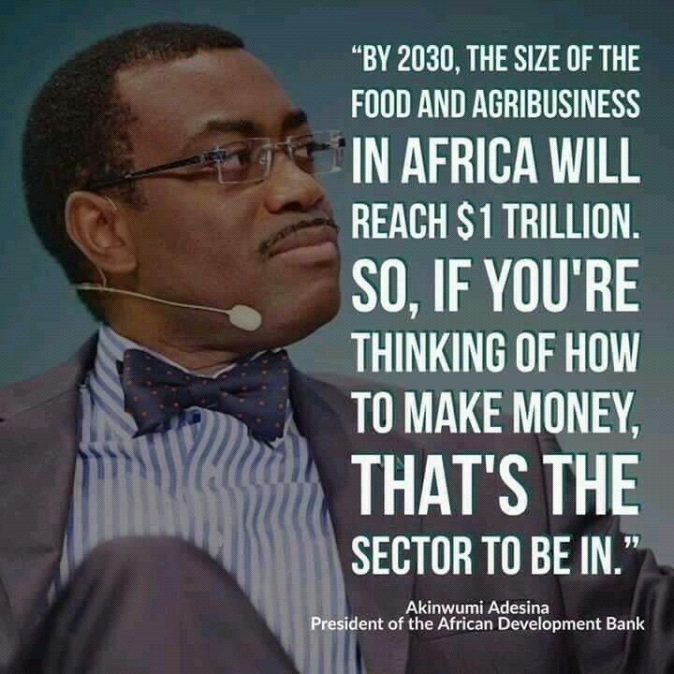
Setting the stage

Slide 4
Agenda 1
The Nigerian economy

Slide 5
Nigerian economy
Following an April 2014 statistical "rebasing" exercise, Nigeria has emerged as Africa's largest economy, with 2015 GDP estimated at $1.1 trillion.
Oil has been a dominant source of income and government revenues since the 1970s.
Nigeria’s economic growth over the last five years has been driven by growth in agriculture, telecommunications, and services. Economic diversification and strong growth have not translated into a significant decline in poverty levels, however - over 62% of Nigeria's 170 million people still live in extreme poverty.
Despite its strong fundamentals, oil-rich Nigeria has been hobbled by inadequate power supply, lack of infrastructure, delays in the passage of legislative reforms, an inefficient property registration system, restrictive trade policies, an inconsistent regulatory environment, a slow and ineffective judicial system, unreliable dispute resolution mechanisms, insecurity, and pervasive corruption.
GDP growth in 2015 fell to around 3%, and government revenues declined, while the nonoil sector also contracted due to economic policy uncertainty. Nigeria went into recession in 2016 due to five quarters negative successive growth but gradually itching out of the Recession as at 2017 Q2

Slide 6
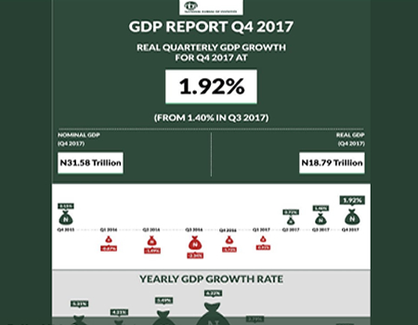
Nigerian economy

Slide 7
Agenda 2
Overview of agricultural sector

Slide 8
Agriculture - overview
Agriculture remains the dominance sector of Nigeria providing employment to about 60% of the work force
The diversity of climatic conditions, the richness of soil types and water resources, and the high population density provide great potentials for crop, animal, fish, and tree production
In the 1960s and up to the early 1970s, Nigeria’s agriculture flourished. The Country was one of the World’s highest producers of palm oil, cocoa and groundnut
Overtime, agriculture has declined in importance. However, there are many signs that agriculture is gaining its past glorious importance
The Country is now the largest producer of cassava roots and yam tubers, rice, soyabeans production in Africa
The total value of agricultural goods’ traded by Nigeria in the second quarter of 2017 stood at N261.9 billion. This represented 4.60 percent of total trade in the period under review, 1.03 percent lower than N30.02 billion recorded in the in the first quarter

Slide 9
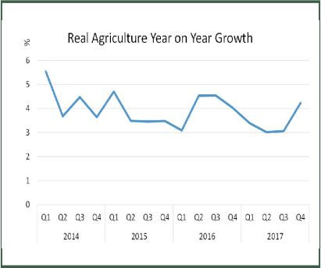
Agriculture and its contribution to gdp

Slide 10
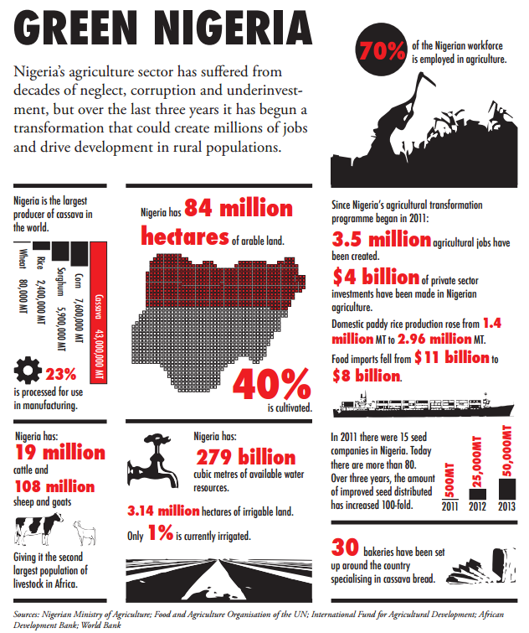
Green economy

Slide 11
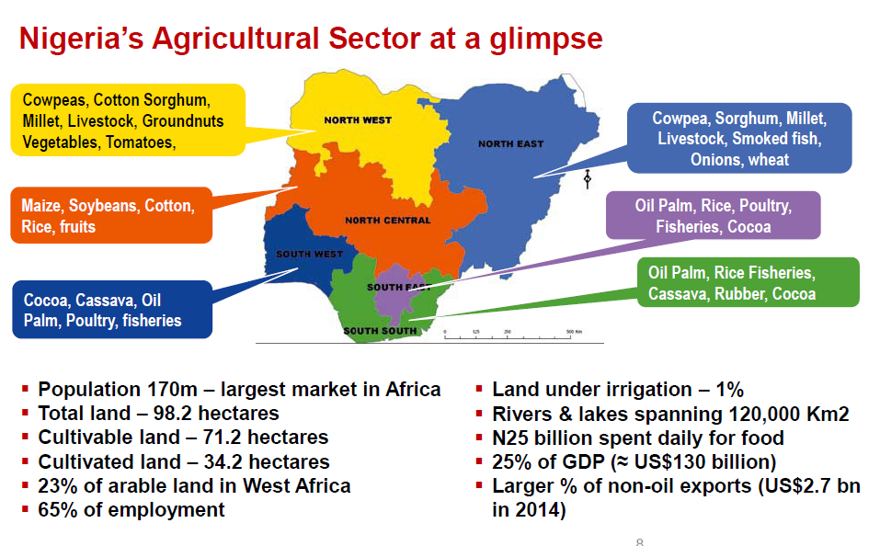
Green economy

Slide 12
Agenda 3
Nigerian non export performance

Slide 13
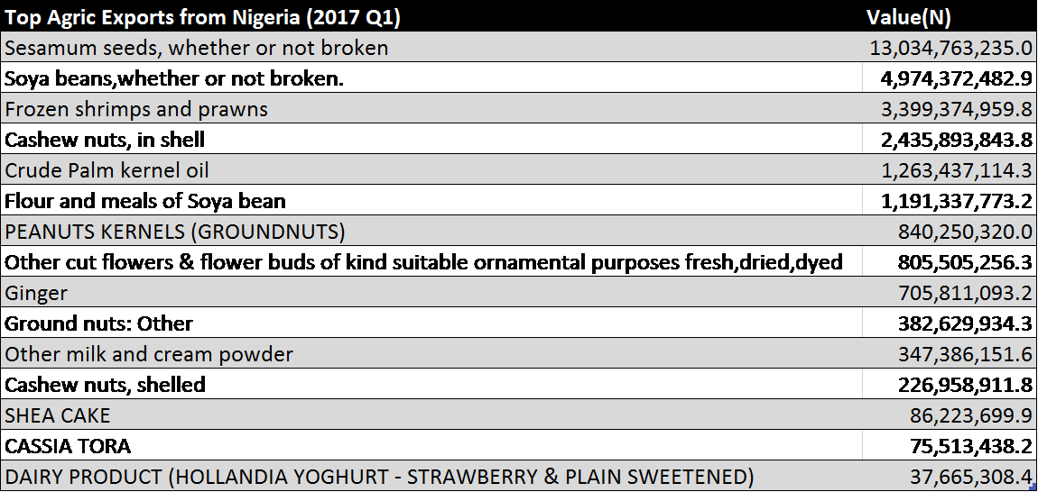
Q1 agric exports
Please note that Q1 was an off season for Cocoa and Cashew

Slide 14
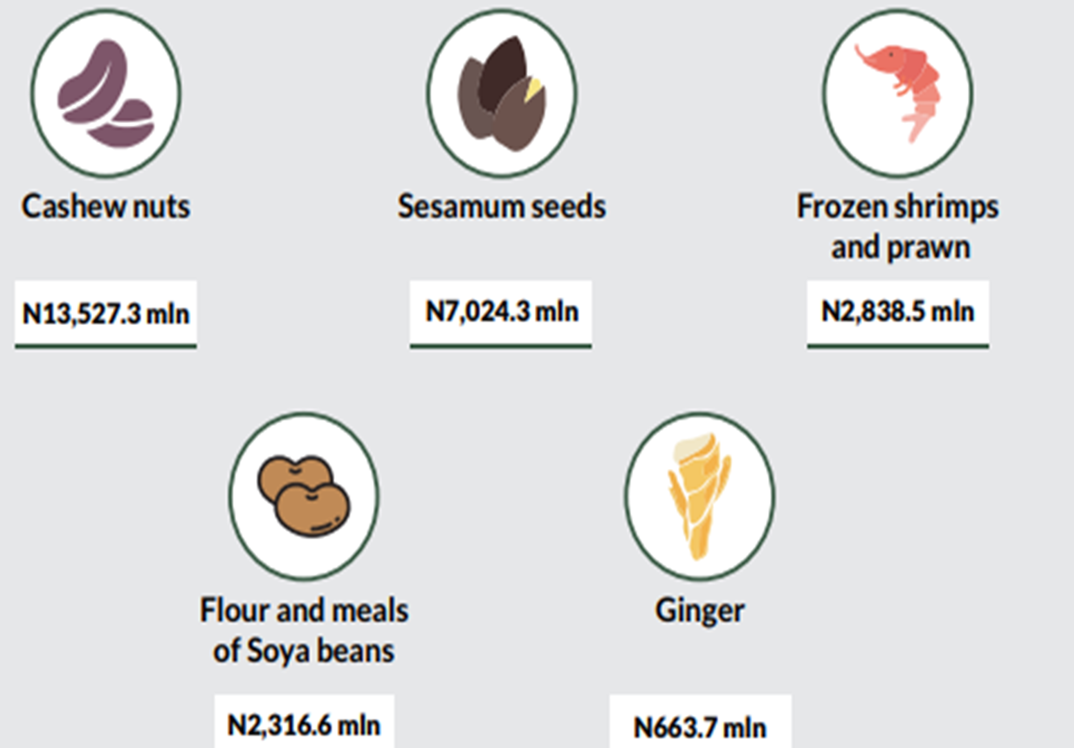
Q2 agric exports

Slide 15
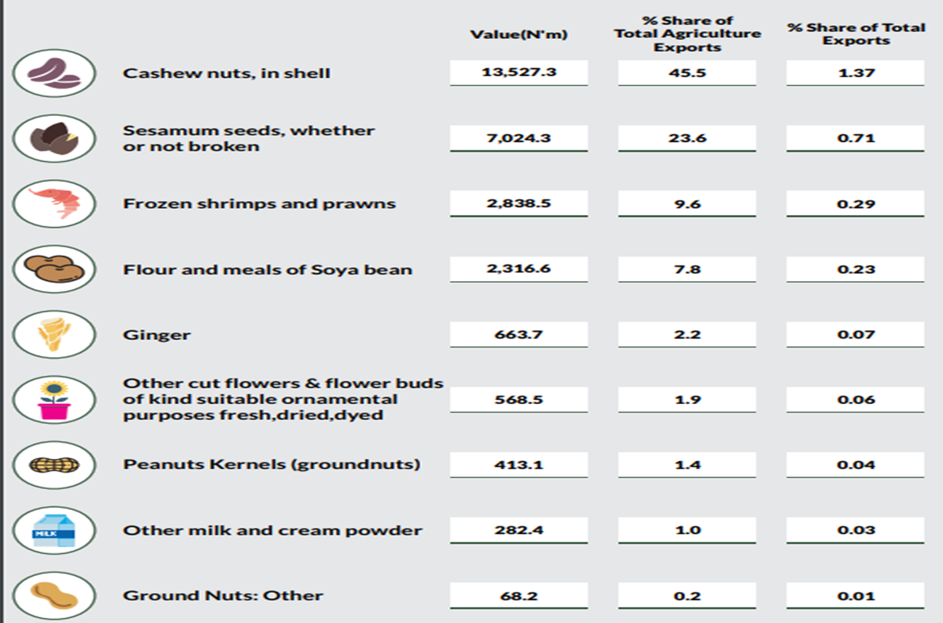
% SHARE OF AGRICULTURAL PRODUCTS EXPORTED IN Q2 2017

Slide 16
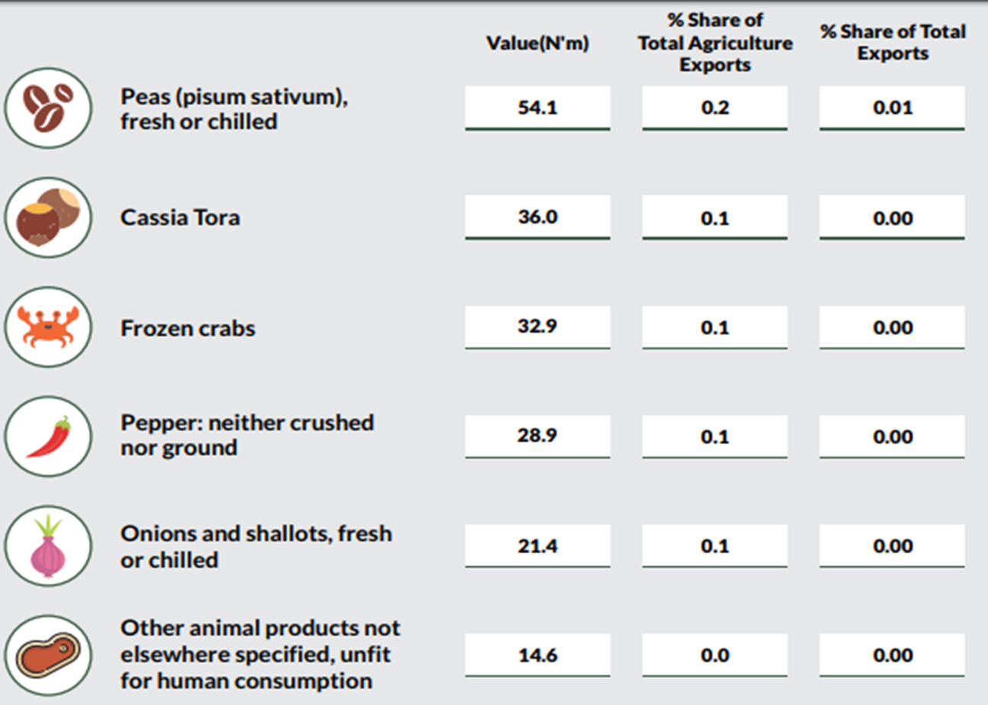
% SHARE OF AGRICULTURAL PRODUCTS EXPORTED IN Q2 2017

Slide 17
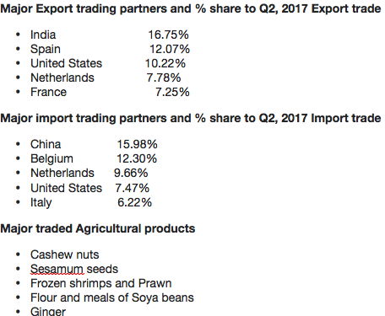
Q2 agric exports

Slide 18
Agenda 4
Why investing in agric and export value chains

Slide 19
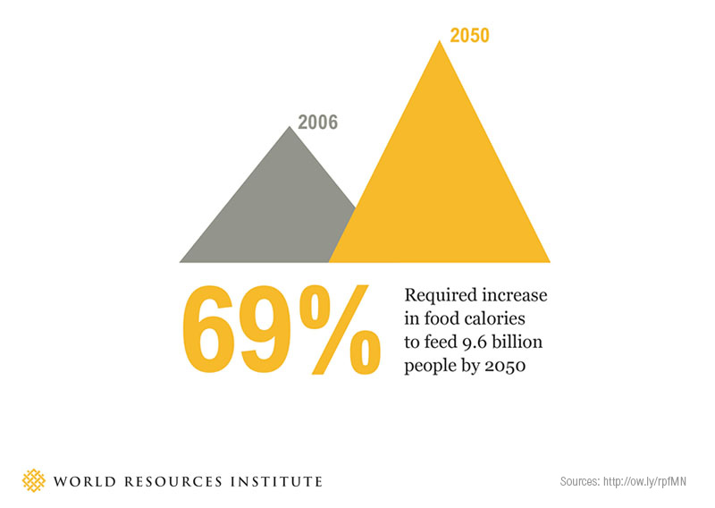
World Food security

Slide 20
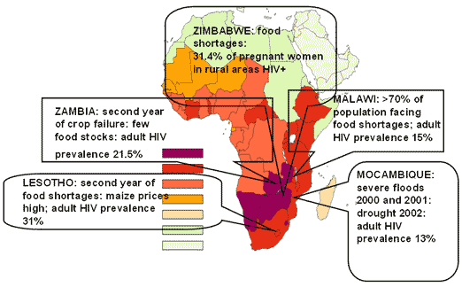
Africa Food security

Slide 21
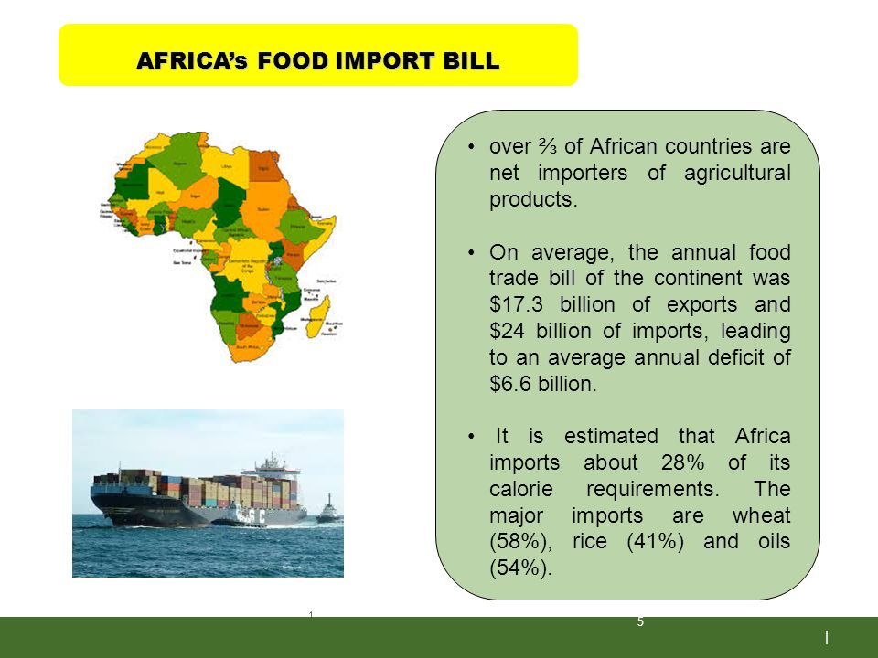
Africa Food security

Slide 22
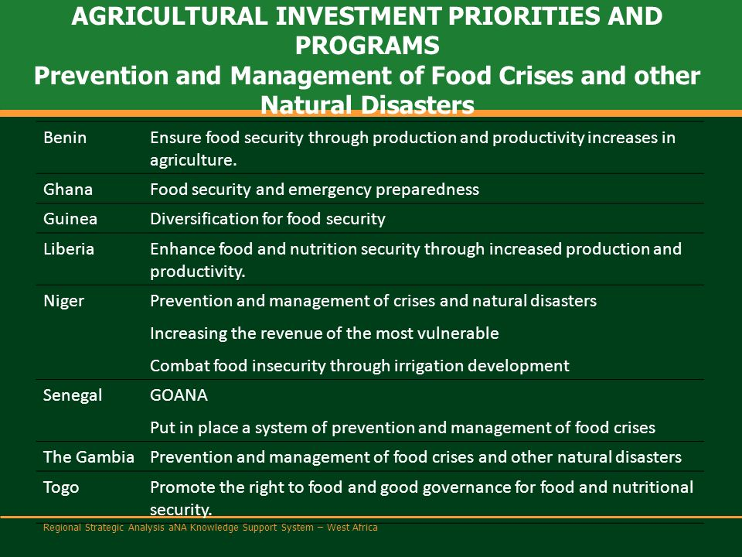
West Africa Food security

Slide 23
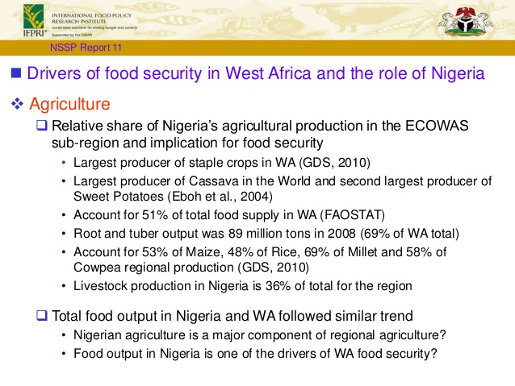
West Africa Food security

Slide 24
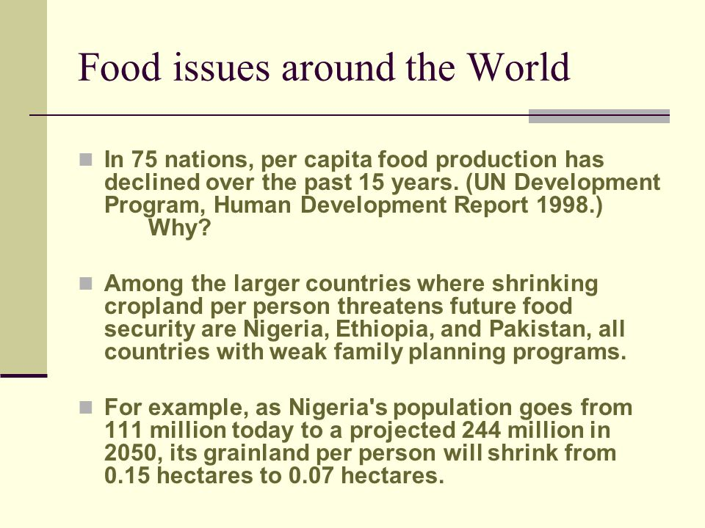
Nigeria Food security

Slide 25
Agenda 5
Investment opportunities in agric and export value chains

Slide 26
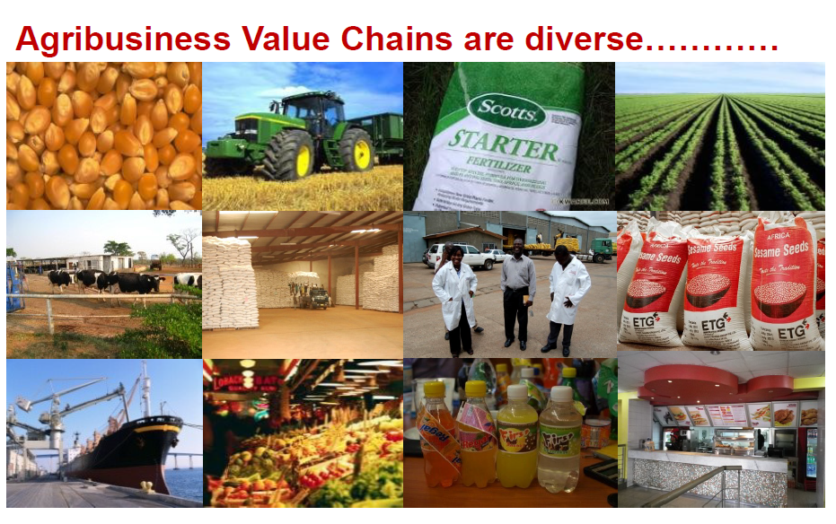
Agriculture and its value chain

Slide 27
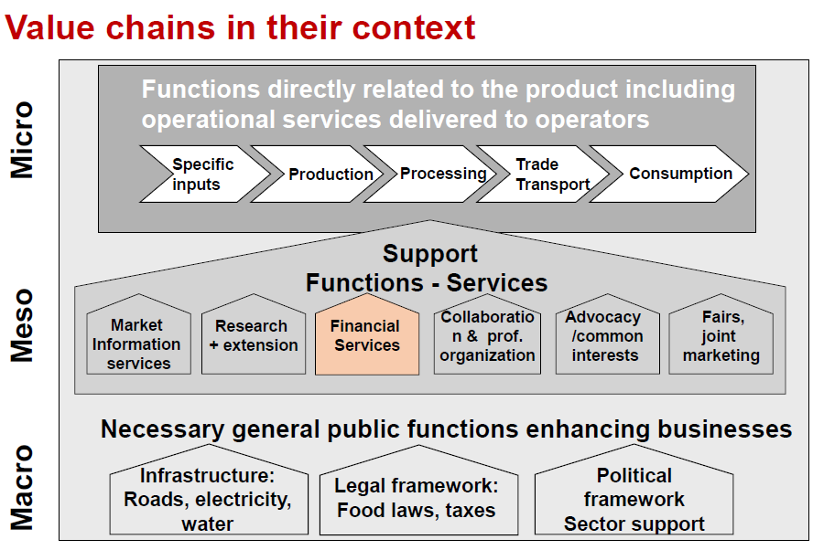
Agriculture and its value chain

Slide 28
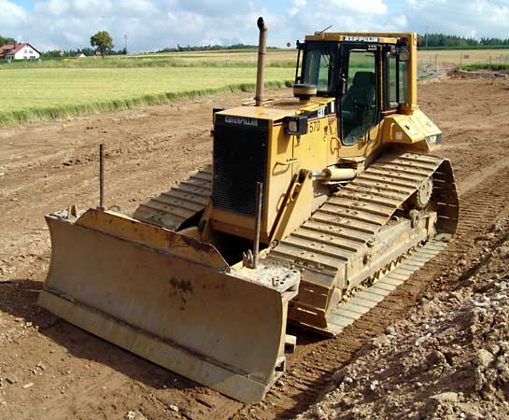

Investment opportunities in agric value chain
Value Chain | Value Chain Description | Opportunities
Pre-Production
Site preparation | This includes land clearing, land preparation and land development | Very few companies currently engaged in providing site preparation services and many farmers are not skilled with good site preparation techniques. Individuals and corporations can provide land development services or consultation on land development techniques
Seed production and distribution | Multiplication of viable, seed resistant and other special species of seeds | The availability of arable land and diverse climatic conditions across the country present good opportunities for seed production. There is a significant gap between the demand and supply of high quality seeds for production. As such, one can start new high-quality seed production companies, invest in existing seed production companies or buy one of the defunct seed companies to transform it.

Slide 29
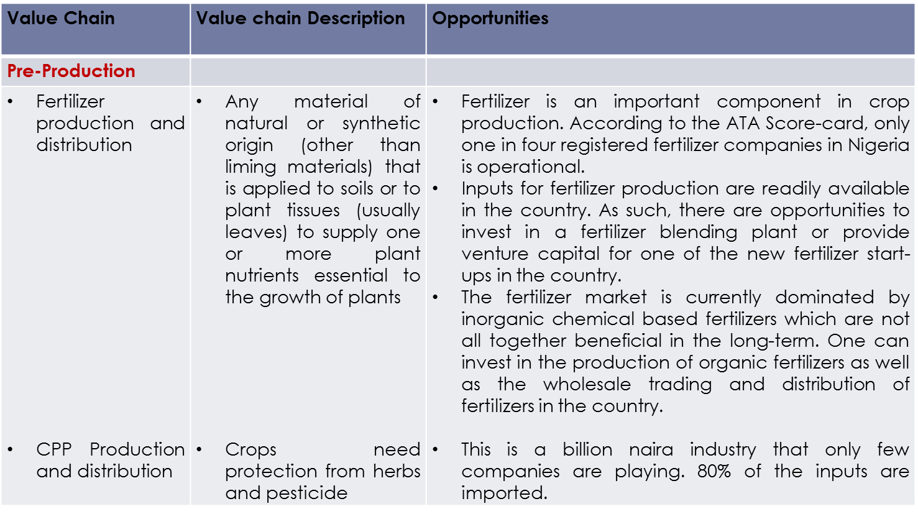
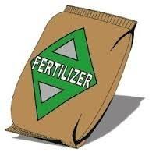
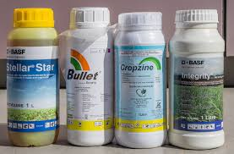
Investment opportunities in agric value chain

Slide 30
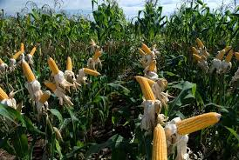
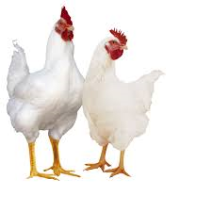
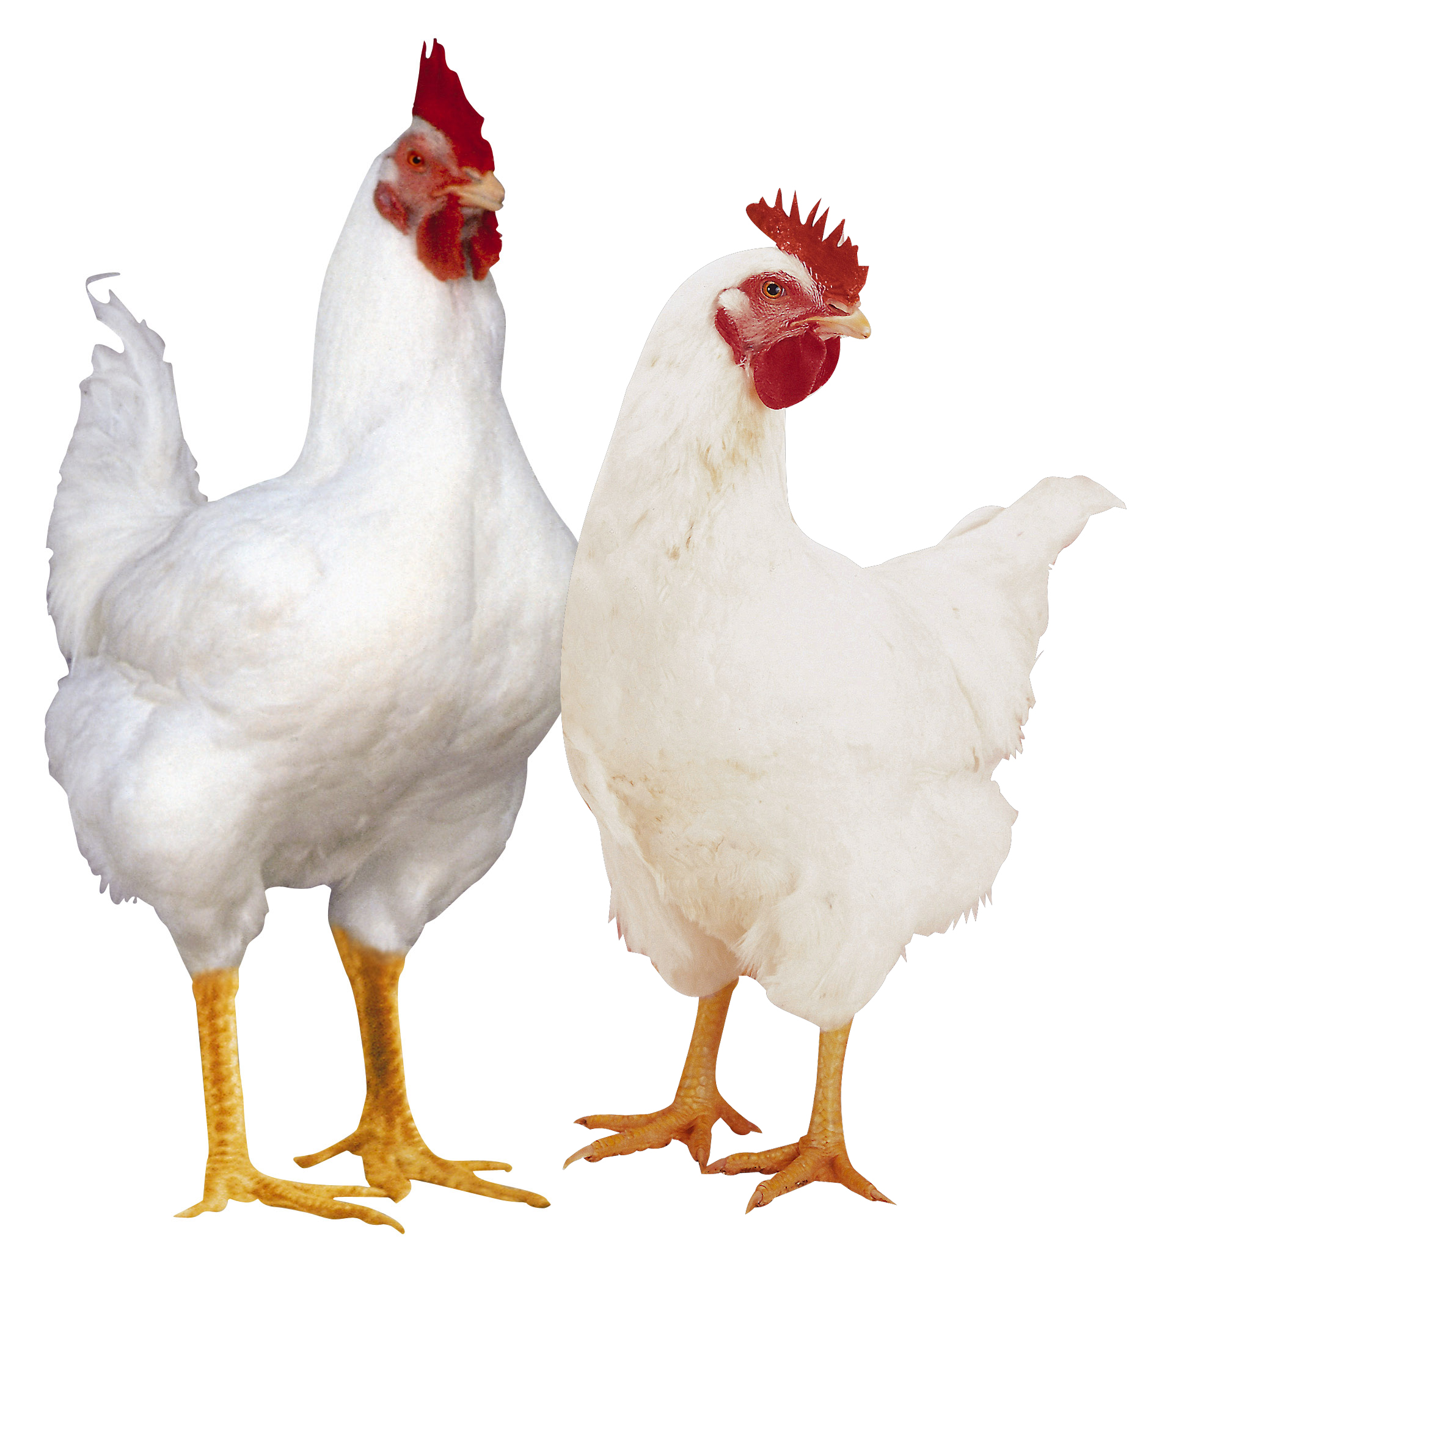
Investment opportunities in the agric value chain
Value Chain | Opportunities
Production
Crop cultivation | There is a significant shortfall in meeting the demand for crops. For example the total demand for rice in Nigeria in 2014 was 5.2 million metric tones (MMT) while local production was 3.3 MMT. It therefore suggests that a production gap of 1.9 MMT valued at USD1.2 billion exists. Prices of food crops are rising and substantial resources are spent on importing staple food such as rice, wheat and sugar. Weather conditions are favourable and most of the land is arable – factors that make the opportunity for farming significant..
Livestock and poultry | increasing urbanisation continues to raise the demand for meat products. Significant resources are spent on importing livestock to Nigeria and there is also an increase in global demand for by-products of livestock i.e. hides and skins. To consider an example, the local demand for poultry in 2012 was estimated at 800,000 MT while local production was 300,000 MT. This resulted in a shortfall of 500,000 MT valued at USD500 million. Opportunities therefore exist in livestock and poultry production. In addition, one can invest in animal feed production, abattoir services or wholesale trading activities for livestock and poultry.

Slide 31
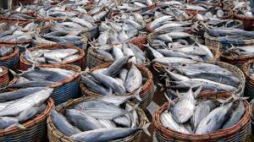
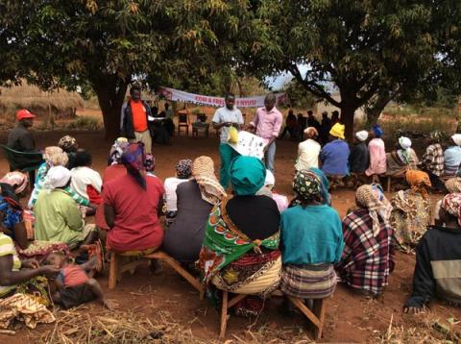
Investment Opportunities in Agric Value Chain
Value Chain | Opportunities
Production
Fisheries | There is an abundance of water in Nigeria teeming with different species of fish. In 2012, N125 billion was spent importing fish into Nigeria. The local demand for fish fingerlings is estimated at 1.5 MMT and local production is 250,000 MT leaving a production gap of 1.25 MMT valued at USD750 million. Opportunities thus exist to produce fish fingerlings, invest in fish farms and produce fish feed.
Extension services | These were previously provided under the World Bank assisted Agricultural Development Projects (ADPs). There seem to be very little of this service currently. It is one area where cutting-edge technology and improved varieties can be transferred to farmers at a small fee. Knowledge is probably the most critical input in agric production Therefore people can establish agricultural extension services in various parts of the country to support farmers.

Slide 32
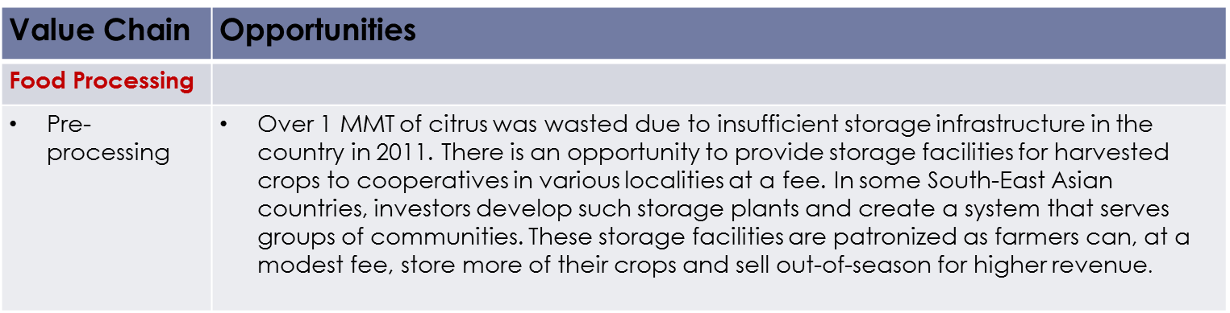
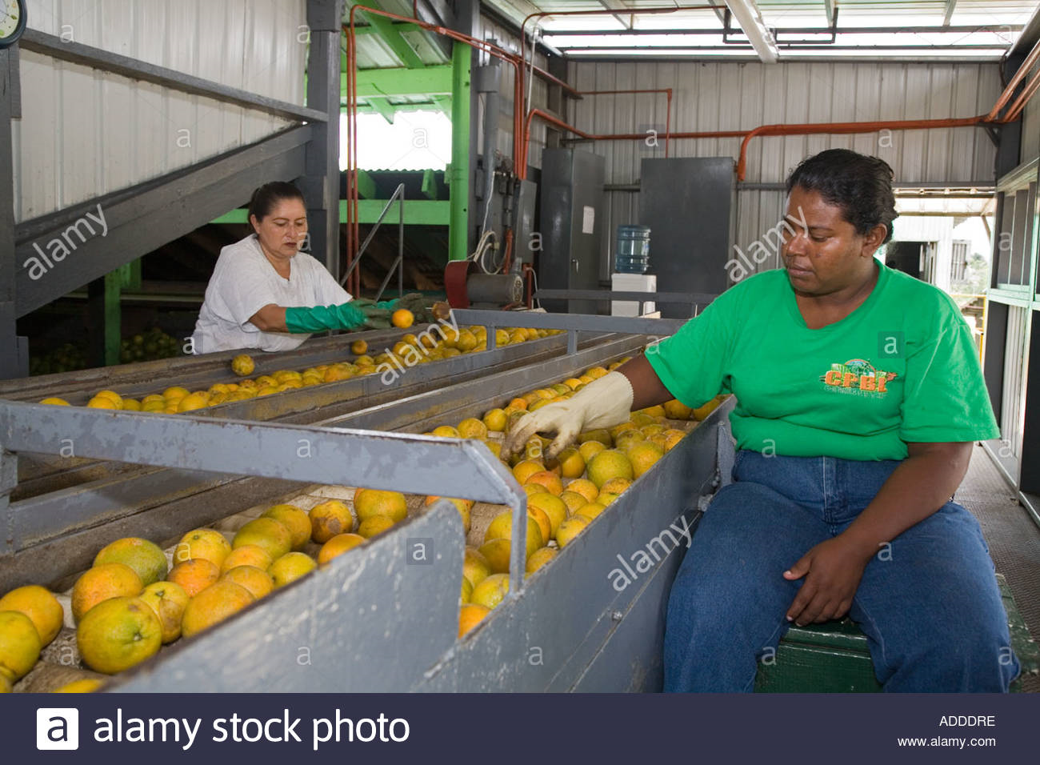
Investment opportunities in agric value chain

Slide 33
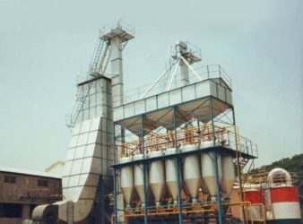
Investment opportunities in agric value chain
Value Chain | Opportunities
Processing | According to the FMARD scorecard, Nigeria produces 30% of all the citrus in the world and 82 percent of all the citrus in Africa, yet remains a net importer of fruit juices. Raw produce is available for processing due to an increase in agricultural cultivation and the government’s incentives aimed at increasing participation in the sector. In recognition of some of these opportunities, there has been increasing investment in Nigeria by multi-national companies such as Cargil. There are higher margins that can be realized from trading processed commodities over raw produce. Most of the concentrates used in juice companies in Nigeria are imported. As such, opportunities exist to process fruits to pulp, concentrates and fruit juices. Those seeking opportunities may consider investing in processing facilities for commodities such as converting tomatoes into tomato paste or tomato ketchup. In addition to actual processing, there is an opportunity to sell or lease out processing equipment and machinery to manufacturers in the sector.

Slide 34

Investment opportunities in agric value chain
Value Chain | Opportunities
Distribution
Storage | An estimated 60 percent of agricultural produce is wasted annually due to limited storage facilities and poor techniques. In recognition of this, there are opportunities to provide storage facilities to farmers and to develop cold-storage facilities in smaller cities across the country.
Distribution
Logistics and distribution | The logistics industry is under developed and dominated by small to medium sized companies. Many of the logistics companies are focused on the oil sector and do not sufficiently serve the agricultural sector. One can start a logistics company aimed particularly at this sub-sector. This means investing in vehicles that are purpose-built for the transportation of agricultural produce. In addition, there are opportunities to provide route planning and supply-chain services to existing logistics companies

Slide 35
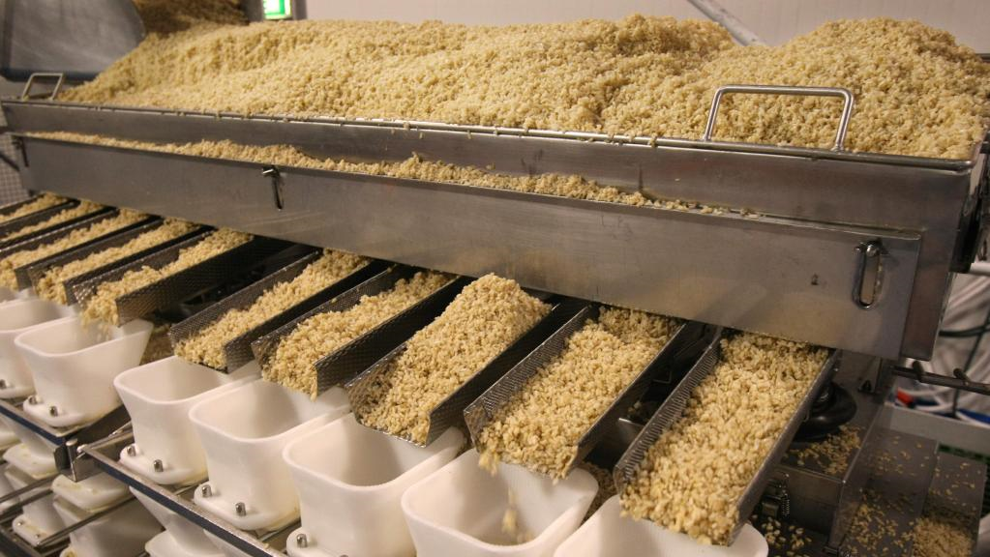
Investment opportunities in agric value chain
Value Chain | Opportunities
Processing | According to the FMARD scorecard, Nigeria produces 30% of all the citrus in the world and 82 percent of all the citrus in Africa, yet remains a net importer of fruit juices. Raw produce is available for processing due to an increase in agricultural cultivation and the government’s incentives aimed at increasing participation in the sector. In recognition of some of these opportunities, there has been increasing investment in Nigeria by multi-national companies such as Cargil. There are higher margins that can be realized from trading processed commodities over raw produce. Most of the concentrates used in juice companies in Nigeria are imported. As such, opportunities exist to process fruits to pulp, concentrates and fruit juices. Those seeking opportunities may consider investing in processing facilities for commodities such as converting tomatoes into tomato paste or tomato ketchup. In addition to actual processing, there is an opportunity to sell or lease out processing equipment and machinery to manufacturers in the sector.

Slide 36
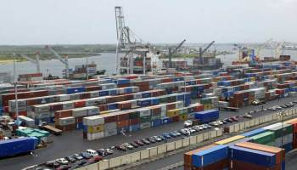
Investment opportunities in export value chain
Exportable goods in Nigeria
Agric products: Cocoa, cashew, Ginger, soya meal, sesame etc
Solid minerals: Iron ore and tin
Made in Nigeria goods

Slide 37
AREAS OF FOCUS IN EXPORT
Agriculture
Manufacturing
Mineral
Industrial
Transport
Food
Other emerging sectors – Services, Entertainment

Slide 38
Agenda 7
Basic tips agribusiness

Slide 39
Basic tips in agribusiness
Interest & Passion
  No quick money in agribusiness
  You must love the process
  Tenacity & perseverance
Management Expertise
  Basic stockman skill required
  Management skills training
  Basic information on input sourcing and markets
Land
  Maintain a balance between distance from residences, infrastructure & access to market
  Source land from the right people and documentation
Capital
  Don’t use debt to finance start up
  What are your profit goals
  Mix of equity & debt
Labour
  It’s a challenge in Nigeria
  Attitude to work
  Ethical challenge

Slide 40
Agenda 8
Basic tips in export business

Slide 41
Basic tips export business
Get the basic Export Training: (These exports training could be from NEPC or any private export training Institution)
  Knowing what it takes to be an exporter
  Choose your product for export
  How to make your business official
  How to find your importers (buyers) or customers
  How to expose your product to exporters
Register your Business
  Register your Company as Limited Liability Company
  Minimum share capital of N1m
  Ensure Form CAC 07 is still within the valid date which is normally 4 years
Register your Company with NEPC
  Visit their Office @ Apapa or www.nepc.gov.ng
Capital
  Don’t use debt to finance start up
  What are your profit goals
  Mix of equity & debt

Slide 42
Agenda 9
Introducing sterling bank plc

Slide 43
Introducing sterling bank plc
Sterling Bank is the product of merger of five Banks ( NAL, Indo-Nigeria Merchant Bank, Magnum Trust Bank, NBM Bank and Trust Bank of Africa) in 2006 consolidation of banking sector
Sterling Bank emerged as one of the 14 cleared banks following the 2009 audit of banking sector by CBN
Acquisition of the business interest of ETB in 2011
Sterling Bank is a full fledged National Bank with over 200 branches spread across the country
Sterling Bank Plc “ the one customer bank” is a full service national commercial bank in Nigeria with asset base close to a trillion naira and shareholders funds in up to N100bn
The bank has a diversified shareholding structure with no party holding more than 15% of the shareholding
Sterling Bank has a strategic alliance with State Bank of India (SBI)
The Bank has Moody Rating of B2 with Stable Outlook, DataPro Limited of BB+ and A2 with GCR of A3 & BBB for short and long term respectively with stable outlook

Slide 44
Agenda 10
Sterling bank exploits in agric financing

Slide 45
Exploits in Agricultural Financing
Sterling Bank became active in Agric Finance in 2011 though financed some transactions through the Legacy Banks
Best Bank in Support of Agriculture by Business Day Banking Awards 2017
Agric Bank of the Year by Nigeria Agriculture Awards (2017)
Best Performing Bank in Commercial Agric Credit Scheme (CACS) by CBN (2014)
Agriculture Bank of the Year by APRNET (2014)
First commercial bank to lend under the CBN Anchor Borrowers’ Programme (ABP) under which over 22,000 smallholder farmers were mobilized in Kebbi, Zamfara, Kaduna, Sokoto and Oyo States
First Commercial Bank to access NIRSAL Scheme
Pioneer Bank in Growth Enhancement Support Scheme and Mechanisation drive (GES)
Part of the team that drafted the guidelines for the Agricultural Sector Sustainable Banking Principle for the Bankers Committee
Developed Strategic partnership with World Bank, AfDB, USAID, UK-DFID, MADE-UK and other development finance institutions
Partnered with some State Governments on their Agric. Intervention programmes. Osun, Kwara, Ondo, Ogun and Bauchi states etc inclusive
Financed the largest Soya Bean Milling Plant in Sub-Saharan Africa and the Largest Rice Mill in Nigeria
Correspondent bank to NIRSAL and partnership with NIRSAL on their Anchor Borrowers Programme by providing banking and agency banking services for loan administration to their farmers across the country

Slide 46
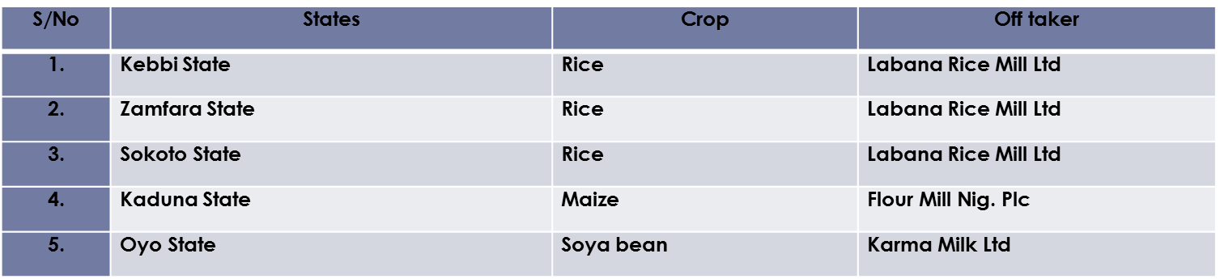
Exploits in Agricultural Financing: Private Sector
We financed the largest Multi Billion Soyabean Refinery Plant in Sub-Saharan Africa. Its located in Ibadan, Oyo State
We financed one of the largest Rice Mill Processing Plant in Kebbi State. The Mill was at the centre of Lagos State ‘’LAKE RICE” Success in 2016
Part financing the working capital for the newly established WACOT Rice Mill in Kebbi State
Sterling Bank recently financed production of raw materials for the following companies leveraging on the Anchor Borrowers Scheme:

Slide 47
Exploits in Agricultural Financing: public Sector
1. Osun State Government
  Broilers Outgrowers Programme for School feeding
  Fish outgrower Programme for School Feeding
  Feeder Access road from rural areas to urban centres
2. Kwara State Government
  Rural access Road programme: Construction of feeder road, culverts and Bridges to link rural areas to urban centres and facilitate product market access
3. Ondo State
  Youth Employment Programme. Establishment of Agro Cities in Ore, Awuga and Ikare.
  Poultry value chain production
  Crop production e.g cassava, maize and soyabean and linkage to Anchors/Offtakers
4. Bauchi State
  Fertilizer distribution to small holders farmers
5. Ogun State
  Production of cassava and Oil palm with linkage to offtakers
  Youth empowerment Programme through Cassava/Poultry/Fishery Value chain
  Women empowerment through Noiler Chicken distributions to rural women
6. Edo State
  Cassava/Maize value chain development for Youth Empowerment

Slide 48
Agenda 11
Sterling bank Agric product suites

Slide 49
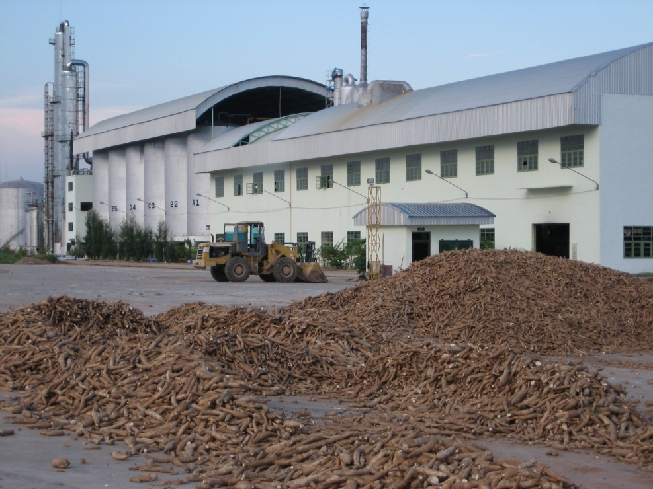
COMMERCIAL AGRICULTURAL CREDIT SCHEME (CACS)
Targets Markets: Medium scale Farms/Agric Enterprise, Corporate and Large scale Commercial Farms/Agric Enterprise and State Government.
Obligor limit: Up to N2bn
Interest Rate: All in of 9%
Tenor: 7 years
Security: Collaterised up to 120%

Slide 50
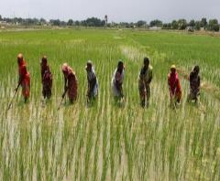
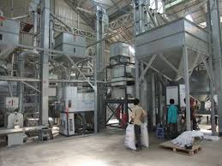
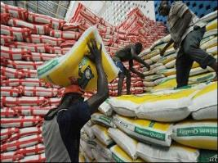
ANCHOR BORROWERS FUND
The beneficiaries must be member of Cooperatives registered within the State
Maximum of 10,000 farmers (Out growers) linked to Off takers out growers jointly identified, trained and grouped by all stakeholders
NAIC Insurance is mandatory
Equity contribution between 5-10%
MOU between the Bank, Offtaker and Farmer Cooperatives
Domiciliation of sales proceeds
Agreed template covering the amount to be disbursed per farmer
N10m per Cooperative
Tenor depending on crops/livestocks
There are four Models under ABP
    NIRSAL led Model
    PFI Led Model
    Prime Anchor Led Model
    State Government Led Model

Slide 51
STERLING TRACTOR ACQUISITION SCHEME (STACS)
TABLE OF CONTENT
Introduction.
Market Gap and Tractor Potential in Nigeria.
Terms and Conditions.
Risk Acceptance Criteria for Groups & Associations
Risk Acceptance Criteria for Individuals.
Risk Acceptance Criteria for State Govt.
Required Documentation.
Transaction Dynamics.
Targets Markets: Groups, Cooperatives and Associations, Individual and State Government.
Obligor limit: N10m, depending on the tractor brands and Horse Power.
Interest Rate: Attractive interest with 40% interest rebate for faithful clients.
Tenor: 36 months with friendly repayment structure.
Equity contribution: 25% from Clients and 75% Guarantee from NIRSAL.
Buyback: Buy back condition from the vendors
Tractor Brands available: Mahindra, Tak, New holland and Massey Ferguson.
Introduction

Slide 52

NIGERIA INCENTIVE-BASED RISK SHARING SYSTEM FOR AGRICULTURAL LENDING (NIRSAL)
TABLE OF CONTENT
Introduction and Background.
Activities covered by NIRSAL Activities.
Eligible Borrowers and Obligors that can utilize Guarantee.
Operating Principles of NIRSAL.
Mechanics for Purchasing Credit Risk Guarantee (C.R.G).
  Risk sharing facility: Risk sharing between 30-80% with CBN.
  Insurance Facility: Decentralization of Agric Insurance.
  Incentive to Farmers: Interest draw back from 20-40%.
Obligor limit: N2bn
Interest Rate : Commercial Rate
Developing a bank rating scheme that will incentivize and showcase/situate banks based on their capacities to lend to the agricultural sector. Lending all ACTORS along the value chain

Slide 53
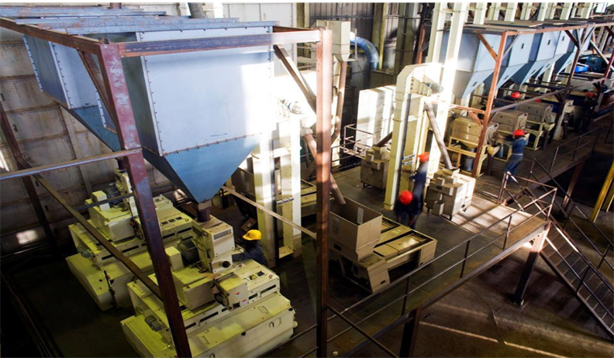
STERLING BANK REAL SECTOR FINANCE SCHEME
Target: Agric value chain, Manufacturing and Services
Interest Rate: 9%
Obligor limit: N10bn
Tenor: 10 years
Moratorium: Moratorium is allowed in line with the project being financed

Slide 54
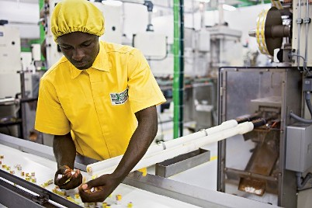
STERLING BANK sme financing SCHEME
Eligible Enterprises: Agric value chain activities, cottage industries
Tenor: Maximum of 5years for SMEs
Amount: Max limit of N50m
Interest Rate: 9% all in rate
Moratorium is allowed in line with the project being financed

Slide 55
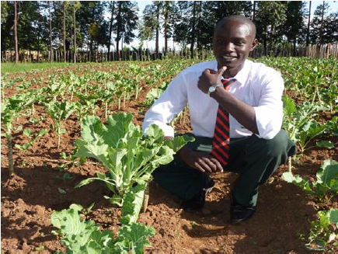
STERLING PAID EMPLOYEES finance PRODUCT
Target Markets: Staff in paid employment of a reputable Companies and Fed/State/LG staff parastatals
Obligor limit: N150,000-N1m for individual and N10m for Cooperative
Interest Rate: All in rate of 22%
Tenor: 18 months
Guarantee: 75% from CBN
Domiciliation of salary
Insurance premium on life and job loss policy
Equity contribution: 25%

Slide 56
STERLING AGSMEIS PRODUCT
Agri-Business Small and Medium Enterprises Investment Scheme (AGSMEIS) is a voluntary initiative of the Bankers’ Committee approved at its 331st meeting held on 9th February 2017
The initiative is to support the Federal Government’s efforts and policy measures for the promotion of agricultural businesses and Small and Medium enterprises (SMEs) as vehicles for sustainable economic development and employment generation
The Scheme shall cover the following activities: Agriculture activities which include production, storage, processing and logistics SMEs in the real sector as well as services sectors which are backward integrated into manufacturing/agriculture/mining/modular refineries including local initiatives in ICT
Investment limit: Up to N2bn
Tenor: Between 3 to 10 years
Eligibility for the fund:
    Compliance with the provisions of the Companies and Allied Matters Act (1990) such as filing of annual returns, including audited financial statements;
    Comply with all applicable tax laws and regulations and render regular returns to the appropriate authorities; and
    Apply through a participating bank

Slide 57
Agenda 12
Sterling bank export products/prog

Slide 58
STERLING BANK/NEPC ZERO TO EXPORT
The zero to export programme, is an initiative by NEPC that simply trains selected individuals and company representatives who know nothing about exports in the basics of exporting non-oil products and guides them through starting until they become big exporters.
Zero to Export programme is a capacity building programme that is a practical mentorship programme, designed for those who have passion and funds to export but don’t know how to go about it.
The programme is a practical mentorship programme that would hand-hold them from day one to the end. “It is an eight week programme where people would be taught on the rudiments of export.
The processes will involve the documentation, procedure, sourcing of products and everything that has to do with export.
As part of its enriching lives proposition and support for the patronage of made in Nigeria goods and services in line with the call for the diversification of the Nigerian economy, Sterling Bank has partnered with NEPC for the Zero to Export programme;
The Bank has so far running two cycles of 8 weeks each in Lagos, and one is ongoing in Abuja

Slide 59
requirements for zero to export
Each participants must have a limited Liability company registered with CAC
The participants must open their company accounts with Sterling Bank Plc
Each account should have a minimum of N5million
Every participant to register with NEPC and obtain export license
Every participant must attend all the 8 weeks training
Each participant must be a member of the cooperative to be formed.
Each Participant must be present during the screening exercise.

Slide 60
STERLING EXPORT STIMULATION FACILITY
The Non-Oil Export Stimulation Facility (ESF) was established by the Central Bank of Nigeria (CBN) to diversify the economy away from oil and to expedite the growth and development of the non-oil export sector
To implement the facility, CBN will invest in a N500 billion debenture to be issued by Nigerian Export-Import Bank (NEXIM) in line with section 31 of CBN Act. This Guideline describes and outlines the operational modalities of the ESF
Eligible Transactions
Export of goods wholly or partly processed or manufactured in Nigeria;
Export of commodities and services, which are permissible and excluded under existing export prohibition list
Imports of plant & machinery, spare parts and packaging materials, required for export oriented production that cannot be produced locally;
Export value chain support services such as transportation, warehousing and quality assurance infrastructure
Resuscitation, expansion, modernization and technology upgrade of non-oil exports industries and;
Stocking Facility/Working capital
Lending limit: The facility shall not exceed 70% cost of the Project and subject to a limit of N5bn
Rate: 9%
Tenor: 9 years for project finance and one year with an option of rollover for working capital

Slide 61
necessary documents for accessing facility
Letter of request detailing the loan usage and amount
Bankable business proposal/Business plan
        Provide detailed information on the company's operating cycle stating the activities involved and number of days Provide justification for the proposed moratorium period (if any)
        Who are the company's suppliers?
        Who are their off takers? ( at least top 20)
Verifiable Export Orders/Contracts or other Export Agreement& Arrangements/Commitments
Relevant permits/licenses/approvals (where applicable)
Cash flow projections with Assumptions for the projections must also be incorporated as well as basis for the projected revenue and expenditure
Equity contribution: the Higher the equity the better the credit
Sterling bank statement at least 3 months and 12 months from other Banks
3 Credit checks that are good on both the company and the promoters
Board Resolution to Borrow(If applicable)
3 years audited financials (Applicable to loan over N20M)
Management account (applicable to loan over N20M)
Valuation report on the collateral( Bank to provide the Valuer)
Environmental Impact Assessment Report
)

Slide 62
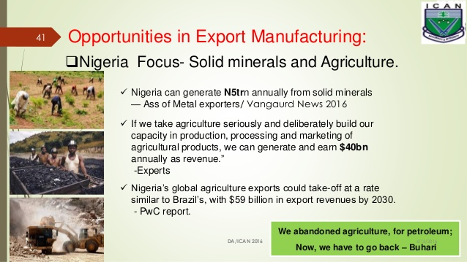
Quotes…….

