Slide 1
SMEs at the Heart of National Development:
Creativity, Capacity And Capital
Keynote Address
By
Ibukun Awosika
GCEO, The Chair Centre Group

Slide 2
Why Talk About SMEs?
SMEs are the engine of growth in any economy.
SMEs provide employment to millions of people
And more...

Slide 3
A World Bank Data
Category | Employee Size | Share of all firms | Share of Employment
Large | 150 – 250 | 0.5% | 40%
Medium | 50 – 100 | 1.5% | 10%
Small | Less than 50 | 8% | 20%
Micro | Less than 10 | 90% | 30%

Slide 4
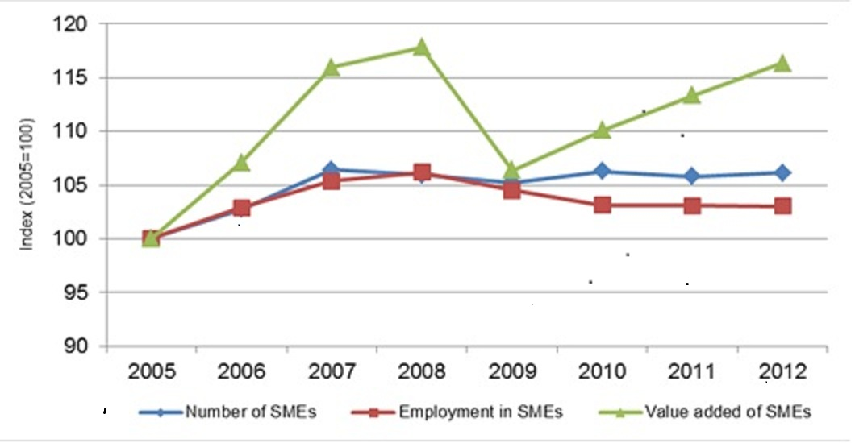
SMEs Between 2005 - 2012
(Source: eu.statistics)

Slide 5
SMEs’ Issues
Capital
Stifling Government Policies
Lack of Infrastructures
Unskilled Manpower
etc

Slide 6
SMEs’ Issues: The Way Forward
The Role of Government
The Role of Private Sector (Finance Institutions and multinationals)
Responsibilities of Individual Entrepreneurs

Slide 7
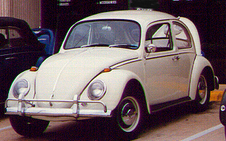

Creativity: What Role?
The roles that thinking out of the box will play in
building businesses along the value chain of each sector of the economy.
innovating processes and products.
achieving competiveness and growing market share.
The new beetle
The old beetle

Slide 8
Value Chain in Agro-Allied Sector
SN | Value Chain | Business Opportunities
1 | Input Services | Production of certified seeds and seedlings Production of certified improved breeds Production of fish fingerlings and juveniles
2 | Farming | Production of Major arable crops Plantation of fruit trees Plantation of Tree Crops Vegetable production and irrigation farming Livestock/Fish Production
3 | Agro Processing | Processing of Cassava, Yam, Maize, Fruits, Oil Palm, Cocoa beans, Soybean, Fish/Livestock, Forest Products
4 | Agro Dealership | Supplying foodstuff and other agro-allied products to restaurants, hotels, schools etc Selling of raw materials and intermediate products to factories Supplying flowers for ceremonies
5 | Industrial Manufacturers | Food and beverages production Manufacturing of Pharmaceutical products Herbal medicine Animal vaccine production Veterinary drugs manufacturing Agrochemicals manufacturing
6 | Trade and Exports

Slide 9
Value Chain in Construction Sector
SN | Value Chain | Business Opportunities
1 | Manufacturing | Aluminium Fabrication, Windows, Awning, Welding, Bricks, Paints, Carpentary, Construction catering
2 | Installations & Fittings | Electricals, Plumbing, Windows, Doors, Roofs, Solar Tubes, Drywalls
3 | Finishing | Ceramic Tile Sales & Installation, Custom, Countertops, Interior and Exterior House Painting
4 | Interiors & Furnishing | Partitions/Office Dividers, Plant Stands, Iron Sculptures
5 | Mortgage/Real Estate | Property Financing, Property Directory
6 | Maintenance & Repairs | Landscaping, Construction Cleanup, Handyman Service, Kitchen Facelift Service

Slide 10
Capacity Building: The Role of Government
What are the roles the government needs to play in helping SMEs to build capacity?

Slide 11
Capacity Building: Entrepreneur’s Role
What are the roles that individual entrepreneur must take to develop capacity?
What got you started may not take you to the next level.
If the drivers of a business are not acquiring additional skills or keeping abreast of industry and “glocal” trends, then the business will stagnate, regress and perhaps become extinct.

Slide 12
Capital: What Role?
 | Kenya | Nigeria | Rwanda | S.A. | Tanzania
SMEs Share of Total Bank Lending | 17.4% | 5.0% | 17.0% | 8.0% | 14.0%
SMEs contribution to banks’ net income | 20.5% | 11.0% | 20.0% | 15.0% | 16.0%
Percentage of revenue derived from credit | 68.0% | 22.4% | 71.0% | 27.0% | 73.0%
Deposit and Account Management | 12.7% | 53.2% | 11.4% | 50.0% | 12.0%
Other transactions and fee-based services | 19.3% | 24.4% | 17.6% | 23.0% | 15.0%
Bank’s Involvement With SMEs (Source: World Bank)

